Slide 1


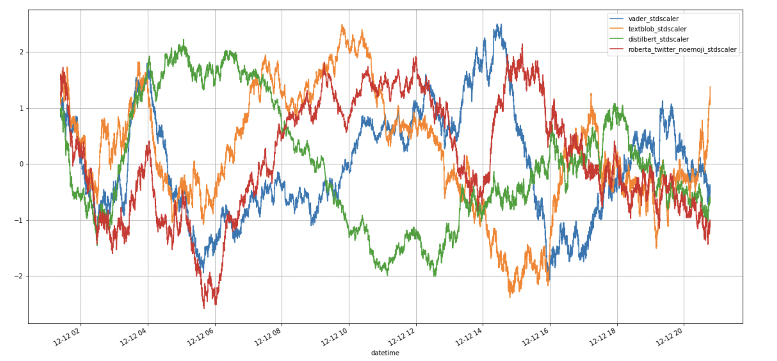
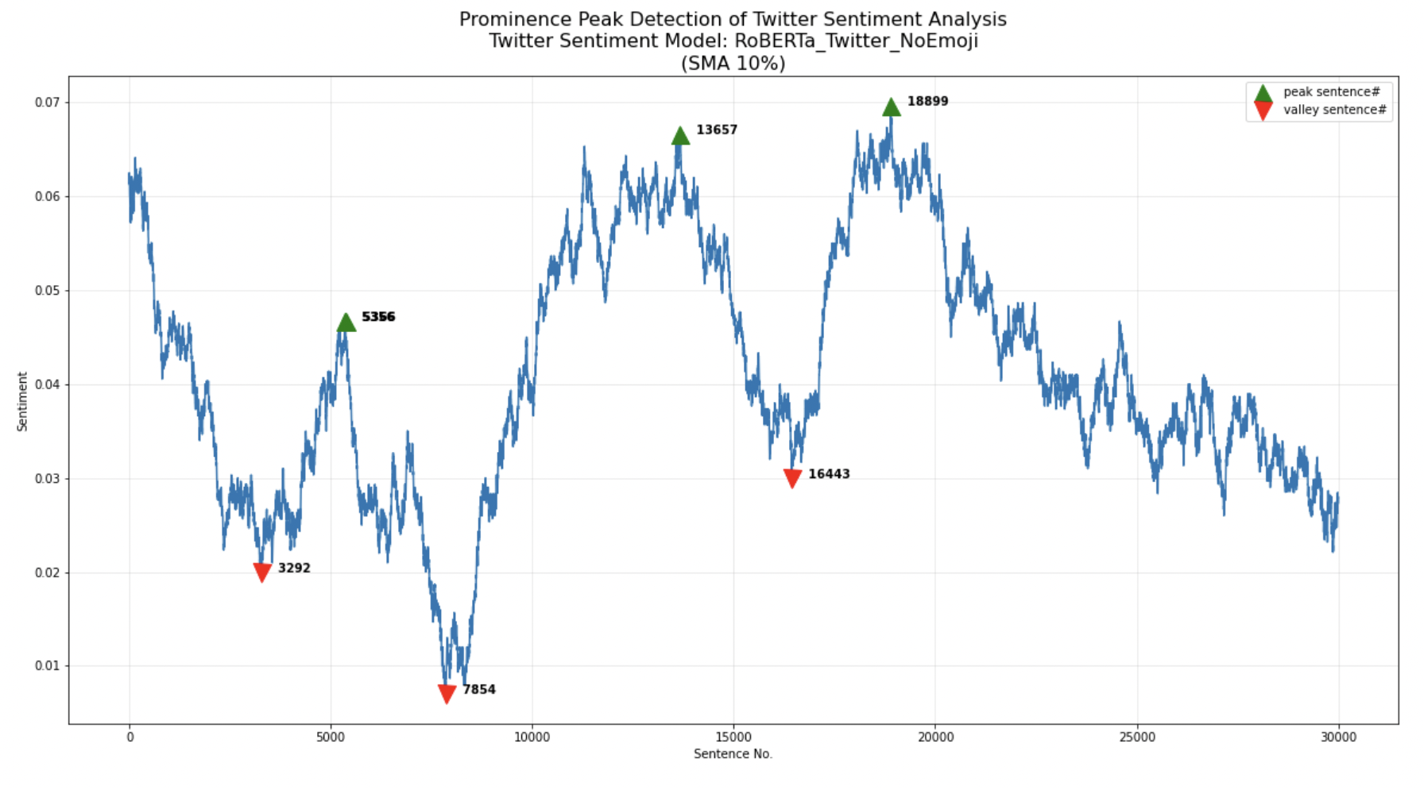
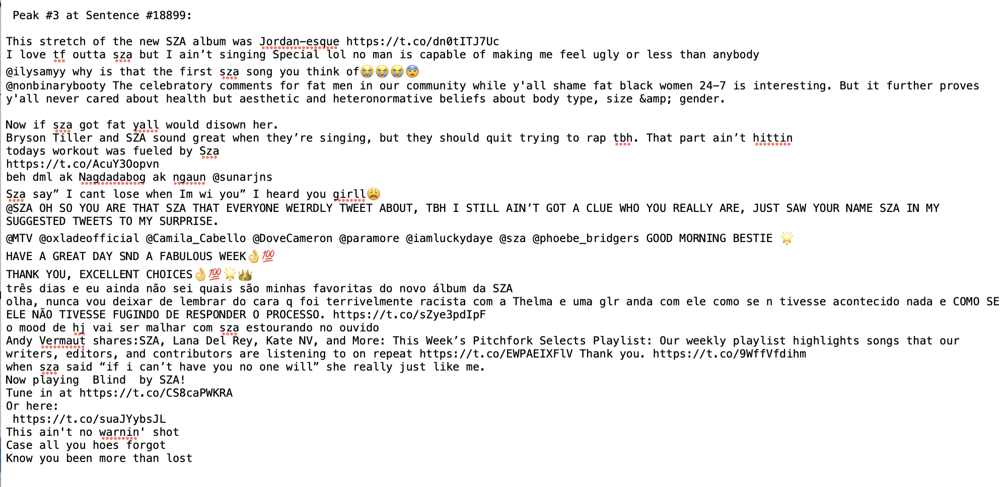
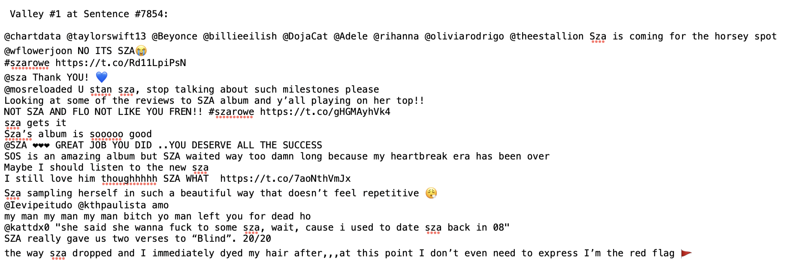
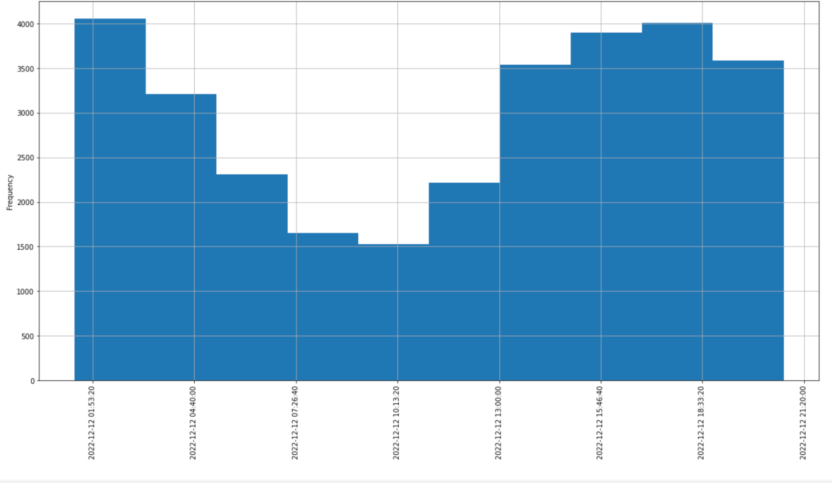
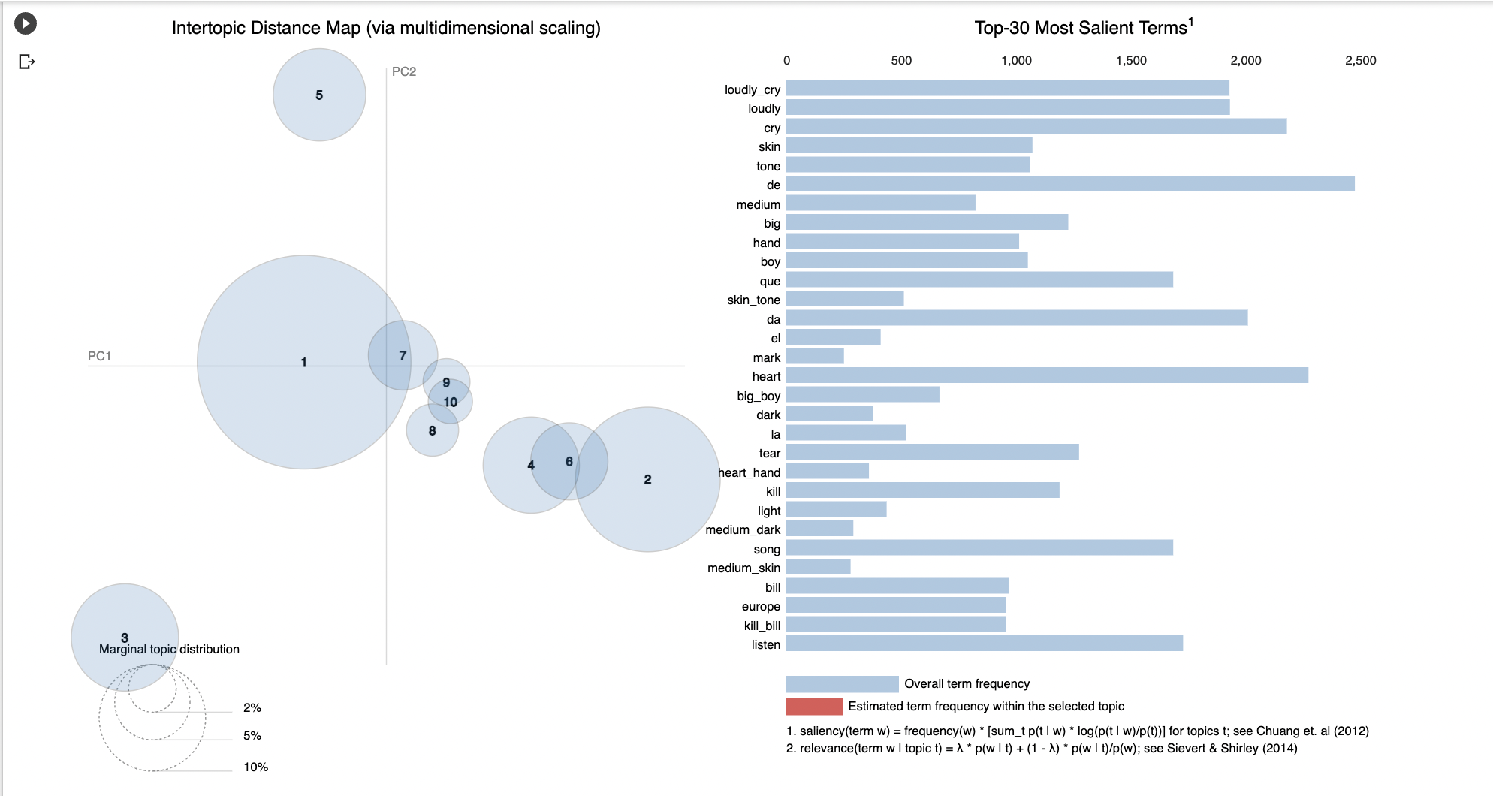
Assessing the Response to a new Album: Sentiment Analysis and Topic Modeling on Tweets about SZA’s SOS
Abby Foster
IPHS 290 Computational Cultural Analytics (Fall 2022) Prof Elkins and ChuKenyon College
Abstract
Sentiment Analysis (cont.)
Topic Modeling (cont.)
In this project, I used the skills I learned this fall in IPHS 290 to perform sentiment analysis and topic modeling on a collection of tweets about the release of SZA’s new album, SOS. Over the past several years, as the prevalence of social media has grown, it has become a hub for people interested in talking about music. If one wants to know what fans think of an artist’s new release, all they have to do is check Twitter and they’ll instantly be able to access the opinions of hundreds, if not thousands, of people. I was interested in seeing how one could use exploratory data analysis and natural language processing to understand the reaction to one such release—SZA’s highly anticipated second album, which features several high profile collaborations.
Disappointingly, I found that the crux analysis was not particularly illuminating. I have trouble understanding how particular tweets conveyed ‘positive’ or ‘negative’ sentiments; additionally, the provided ‘context’ around each crux was especially unhelpful, as the tweets are from completely different users and have no relation to one another. Overall, I found crux analysis to be an unhelpful tool in exploring these tweets. It is also true, though, that sentiment analysis overall is better suited to text that occurs over a much greater amount of time. Also, the feature of including ‘context’ around a particular crux is quite helpful when one is looking at a novel where the surrounding context is relevant.
Of the ten topics, there appear to be four distinct clusters; topics 1, 7, 8, 9, and 10 all appear to be semantically similar, and topics 4, 6, and 2, appear to be semantically similar, with topics 3 and 5 on their own.
Topic 1 is the largest of the topics, including 40.2% of tokens. It includes some of the most frequent words within the dataset. The top 10 most relevant terms in this topic are ‘heart,’ ‘like,’ ‘new,’ ‘listen,’ ‘love,’ ‘song,’ ‘get,’ ‘say,’ ‘smile,’ and ‘good.’ Further down, ‘new_album’ also appears. This topic is the one that most explicitly includes reviews of SZA’s new music itself, as well as generally positive terms. Topics 7, 8, 9, and 10 are all much smaller than Topic 1; they each include less than 5% of tokens. Additionally, each of their terms appear very infrequently. The top five terms for these Topics are, in order: ‘head,’ ‘speak,’ ‘listen,’ ‘get,’ and ‘song’; ‘de,’ ‘hand,’ ‘song,’ ‘ri,’ and ‘da’; ‘mark,’ ‘cross,’ ‘button,’ ‘cross_mark,’ and ‘check’; ‘cabello,’ ‘kill,’ ‘clown,’ ‘kill_bill,’ and ‘bill.’ ‘Kill Bill’ is the name of one of the popular songs on the album, which is why these words appear so frequently.
Topic 2 is the next largest topic, comprising 18.4% of tokens. However, it is much less coherent than Topic 1; the top five most relevant terms are ‘da,’ ‘que,’ ‘de,’ ‘europe,’ and ‘nao.’ The top five terms for Topic 6 are similar: ‘de,’ ‘el,’ ‘la,’ ‘que,’ and ‘en.’ However, though Topic 4 is grouped near those two, its top five terms are different: ‘big,’ ‘boy,’ ‘big_boy,’ ‘da,’ and ‘de.’
Topic three was the most interesting to me. Comprising 10.1% of tokens, the top 10 most relevant terms were ‘skin,’ ‘tone,’ ‘hand,’ ‘medium,’ ‘skin_tone,’ ‘light,’ ‘dark,’ ‘heart,’ ‘heart_hand,’ and ‘medium_dark.’ These were not words I anticipated being so prevalent in the tweets about the album. The contents of Topic 5, on the other hand, were more expected; the top ten terms were ‘cry,’ ‘loudly,’ ‘loudly_cry,’ ‘tear,’ ‘face_tear,’ ‘joy,’ ‘like,’ ‘fire,’ ‘new,’ and ‘da.’ This topic, along with Topic 1, seems the most straightforward in terms of containing reactions to the album.
Figure 2. Sentiment analysis on a sample of 30k tweets with the keyword ‘SZA.’ The range of the data is from 2 am to 8 pm on December, 12, 2022, three days after the album SOS was released.
Introduction
All of the skills I learned to complete this project I learned in IPHS 290. In this course, we explored different ways to collect, process, and organize information. We began by learning how to work with geospatial data in python using GeoPandas, OSMnx and Leaflet. We then explored ArcGIS as a tool to create our own visualizations. In this unit we read some chapters of Bonny P. McClain’s Python for Geospatial Data Analysis as reference. We finished by making our own geospatial visualizations in small groups.
After this project, we looked at web scraping, using BeautifulSoup to build a Web Scraper and learning about XPath. During this unit we also learned how to use VSCode and set up a virtual environment on the command line, which we did thorough Anaconda. These skills would continue to be useful throughout the rest of our course. Then we explored the Twitter API and experimented with using Tweepy, Postman, and snscrape to access information about tweets and users. We also looked at using JSON and MySQL in Python. We also scraped Reddit and Instagram with Python.
Next, we looked at AI generated art and compared three different text to image deep neural networks: DALL-E 2, Midjourney, and Stable Diffusion. We combined these tools with the skills we had learned in previous units to scrape information about this AI art from social medias like Reddit and Twitter with the goal of scraping images and prompts to learn more about AI prompt engineering.
Finally, we used NetworkX to analyse social media networks to measure factors like centrality and grouping. Then we looked at natural language processing, including performing sentiment analysis on novels and tweets as well as exploring topic modeling.
Figure 4. I have included two cruxes from the RoBERTa model—the highest peak and the lowest valley. Ideally, these would be the sentences with the most positive and the most negative sentiment. It is my understanding that the selected sentence is in all caps, and the other sentences around it are context; however, I could be mistaken. It is also difficult to tell what is capitalized by the tweet user and what is capitalized by the model itself.
Figure 3. This figure shows the peaks and valleys detected by the RoBERTa sentiment analysis model.
Topic Modeling
Sentiment Analysis
After finding that I did not get satisfactory results from sentiment analysis, I moved on to topic modeling, and explored what common words were being used in these tweets.
After inputting the cleaned tweets and putting them into synthetic documents of ten tweets, I experimented with different numbers of topics in the Gensim LDA model. At first, I used the default ten topics, but I wasn’t wholly satisfied with the resulting visualization. However, when I tried twelve and fifteen topics, I found that they became too small and overlapped too much to draw any real conclusions. Therefore, I decided to use ten topics.
I began by scraping 30,000 tweets with they keyword ‘SZA.’ Due to the large amount of tweets about her new album, all of the ones I scraped were from the same day. This unfortunately limited the types of data analysis I would be able to do, but still allowed me to find some interesting results.
After gathering these tweets, I performed a sentiment analysis using four different models: VADER, TextBlob, DistilBERT, and RoBERTa. The results of this analysis are shown above in Figure 2. Just from looking at the graph, it’s clear that these models were not in agreement about the sentiment of the tweets; DistilBERT especially tended to disagree with all the other models. The raw means for each of these models was: VADER = 0.08; Textblob = 0.06; DistilBERT = -0.23; RoBERTa = 0.04. This means that every model besides DistilBERT judges the sentiment of the tweets to be positive, but only slightly.
Next, I chose one model in particular to look at crux detection. I chose to look at RoBERTa, as it was trained specifically on tweets and it aligns (for the most part) with the other two models. I looked at the Prominence Peak Detection for this model to ascertain the points that it had assessed as being the farthest from a neutral sentiment. As these tweets were all taken from different points throughout the same day, it is impossible for us to draw conclusions based only on how the sentiment of the tweets changed over time. However, we can still analyze the peaks and valleys of the graph: the tweets with the most negative and most positive sentiment.
Conclusion
My conclusion after completing the exploratory data analysis through natural language processing tools is that Twitter is a good place to find varied and frequent reviews of new music. However, sentiment analysis is a less useful tool to explore such tweets, especially when they take place over a short window of time. Topic modeling is more helpful, but while some topics can clearly indicate the different reviews of listeners, other are less helpful, or not helpful at all. I feel that the process I have performed could be useful to lots of different people; for example, a reporter trying to assess the public’s reaction to newly released music, a consumer trying to know what new music to listen to, or even an artist trying to assess how their work was received.
Image Citations
https://pitchfork.com/reviews/albums/sza-sos/
https://www.slantmagazine.com/music/sza-sos-album-review/
Figure 1. A histogram showing the frequency of the tweets I collected against the time they were tweeted. This shows that the most common time for these tweets was around 2 AM and 5 PM, with the least common time being 10 AM.
Figure 5. Topic modeling on the 30k tweets I collected with the keyword ‘SZA.’ I decided to group them into 10 groups. Additionally, on the right are the 30 most salient terms throughout the tweets.

